Slide 1
Post-quantum Public Key Cryptosystem (PKC) (Code-based)
Rashmi Agrawal

Slide 2
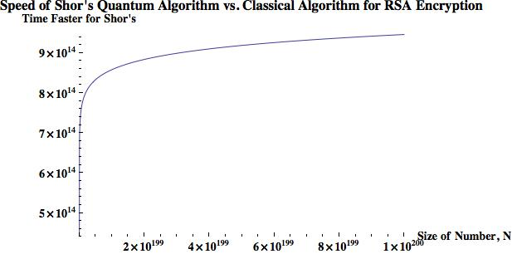
Prediction: 2016
Who is considered as non-post-quantum secure?
*
To break a 768-bit RSA:
2 years for a current super computer
1 nanosecond for a quantum computer
(log N)²(log(log (N))(log(log(log(N)))
N: key size in decimal digits
* Zak Burkley, The Teachings of a Quantum Cat, 2016
Notes:
We have seen this chart before which compares the speed of shor’s quantum algorithm to a classical algorithm. Focusing on the outcome of this comparison, Predictions in 2016 were that breaking a 768-bit RSA. QC can do that in 1 ns using Shor’s algorithm whereas it will take 2 years for a current supercomputer to break it. We were actually worried about 768-bit RSA at that point in time.

Slide 3
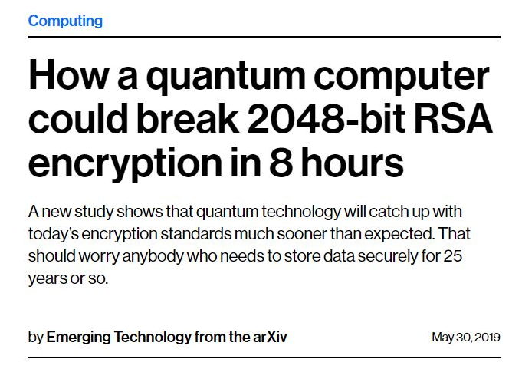
Prediction: 2019
https://www.technologyreview.com/s/613596/how-a-quantum-computer-could-break-2048-bit-rsa-encryption-in-8-hours/
Notes:
Predictions in 2019 QC can break 2048-bit RSA encryption in 8 hours. 2048-bit RSA which is considered as one of the most secure public-key encryption schemes will not be secure anymore. Now we are worried about the security of 2048-bit RSA.

Slide 4
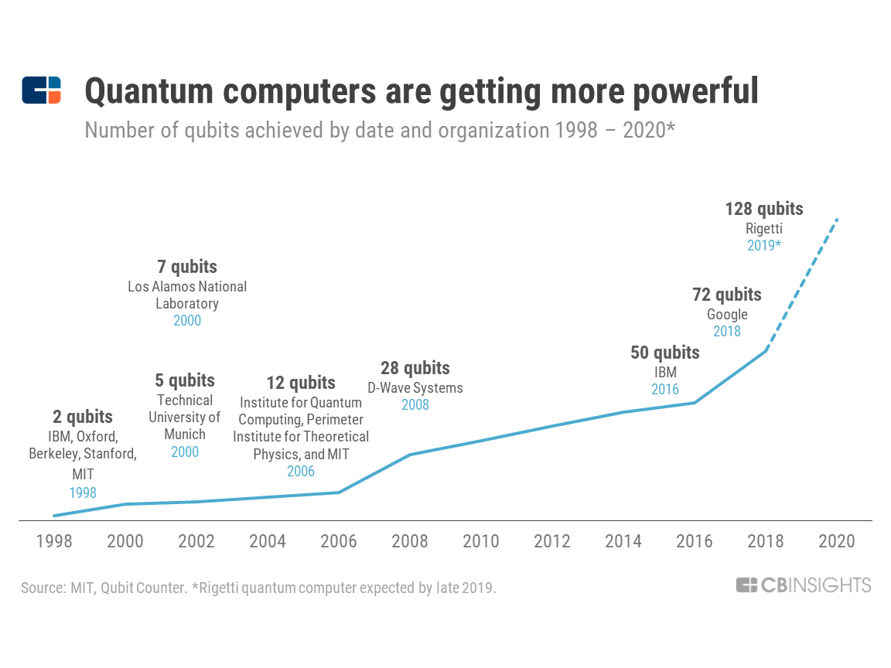
Notes:
Because slowly and steadily quantum computers are getting more powerful. This is a recent progress chart for developments in the field of quantum computing. From 1998 to 2008 the progress was actually very slow but suddenly there was a shift and IBM released their first 20 qubit QC, then they extended the architecture and released a 50-qubit QC as well. In March 2018, Google claimed its 72 qubit chip solved a carefully selected problem faster than classical machines. Shortly after the announcement, Alibaba’s researchers announced they had solved the same problem using classical systems. Now Rigetti is expected to have their 128 qubits QC ready by late 2019. Having said that

Slide 5
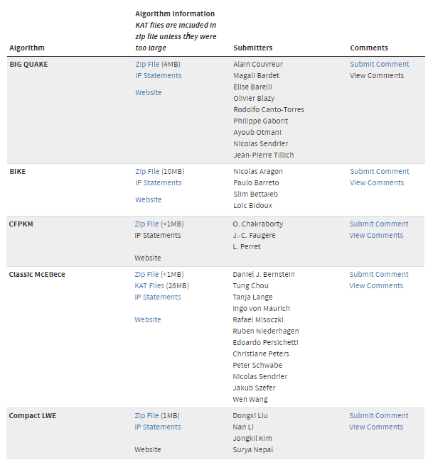
Post-Quantum Cryptography (PQC) Standardization (Round-1)
NIST
Jan 2017 – Dec 2018
Evaluating 69 (5 withdrawn) submissions of PQC, to bring up a standard (just like AES):
21 lattice-based
18 code-based
Some hash-based
Some others
[1]
Submission deadline Nov 30, 2017. List updated Dec 17, 2018.
[1] https://csrc.nist.gov/projects/post-quantum-cryptography/round-1-submissions
Notes:
Let’s recall the NIST’s standardization process for PQC. Round-1 started in Jan 2017 which saw some 69 submissions in which 21 were lattice-based, 18 were code-based, some hash based and multivariate-based. We have already seen the Public-key encryption scheme based on lattice using R-LWE. We will switch gears and dive into code-based public-key encryption scheme. You can see they are quite close to each other in competition.

Slide 6
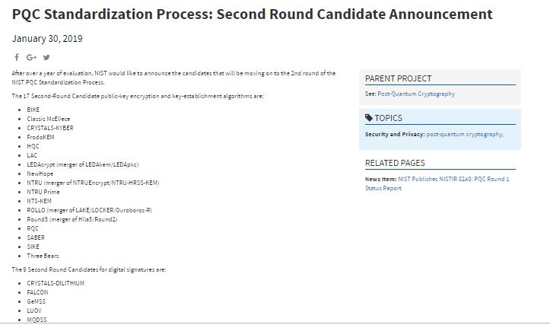
Post-Quantum Cryptography (PQC) Standardization (Round -2)
NIST
Jan 30, 2019 published candidates of Round-2:
26 submissions
Who survived?
12 lattice-based
8 code-based
some multivariate-based and hash based for digital signatures
Notes:
In Jan 2019 NIST published first round results. Out of some 69 submissions only 26 submissions were declared as the second round candidates. Who survived the battle? Lattice based, code based and few other multivariate based and some hash-based for digital signatures. Again lattice-based and code-based are quite comparable in terms of number of candidates.

Slide 7
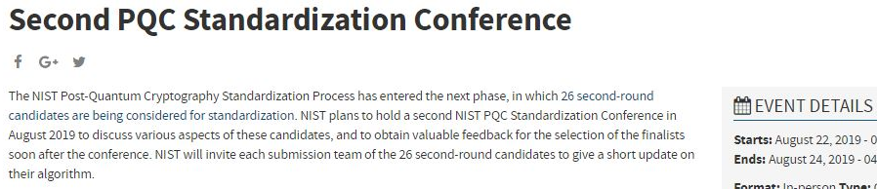
Post-Quantum Cryptography (PQC) Standardization (Final Results)
NIST
Second PQC Standardization Conference
Discussion on these candidates and obtain feedback
Updates on algorithm
26 submissions
Final Results
Notes:
NIST is organizing the second Post-quantum standardization conference in Aug at UC Santa Barbara. The goal is to discuss various aspects like key size, key space, security etc for these candidates and to obtain valuable feedback. Soon after the conference the final results will be announced. May be by September we will know the final winner. While we have developed R-LWE based Public Key Encryption Scheme, we also want to design code-based system as well.

Slide 8
Why Code-based?
Ring-LWE only being out for about 6 years and has not withstood the test of time
The security reduction (hardness) is a modification of SVP & CVP[1]
While, code-based cryptosystem (published in 1978, 41 years of examination) can be used, although:
Its encryption and decryption is much faster compared to RSA
Its key size is large: 1MB
[1] Oded Regev et. al., On Ideal Lattices and Learning with Errors Over Rings, 06/2013
Notes:
The reason is Ring-LWE is a fairly new encryption scheme. Was released some 6 years ago and has not withstood the test of time. Code-based cryptosystem specifically McEliece cryptosystem was proposed in 1978 i.e. 41 years ago. So it has withstood the test of time. Another advantage is that this approach performs encryption and decryption faster than RSA. But rarely being used in practice why? Due to its large key size i.e. around 1 MB. By the end of the presentation you will understand why it is so?

Slide 9
Code-based Encryption
McEliece cryptosystem
Error Correction Code (ECC)
A (n, k, t) ECC code C:
k: size of your message (information)
n: size of the encoded message (codeword)
t: # of random errors C can tolerate
Notes:
McEliece cryptosystem is based on a error-correcting codes and is one of the first and most successful cryptosystem based on notions of coding theory. The original construction uses binary Goppa Codes to encrypt and decrypt messages. We will use a different code namely OLSC for our construction. (Density is 1/q) Decoding complexity of Goppa codes is higher and hence we use different codes. MC brings in the reliability of error-correcting codes into the security of the public key encryption scheme.

Slide 10


Code-based Encryption
McEliece cryptosystem
Error Correction Code (ECC)
A (n, k, t) ECC code C:
k: size of your message (information)
n: size of the encoded message (codeword)
t: # of random errors C can tolerate
Generating matrix G for C:
When m is encoded by G to C, it can still be recovered even after being distorted by t errors
C
1
n
G
n
$$×$$
k
k
$$=$$
1
m
Notes:
So ecc use a generator matrix for that particular error correcting code to encode the message. For example: if you have a k-bit vector of message and you encode is using kxn generator matrix, you will get a codeword of size n-bits. Where n is larger than k. This is an important property of the error-correction codes. An error-correcting code is a process of adding redundant data, or parity data, to a message, such that it can be recovered by a receiver even when a number of errors (up to the capability of the code being used) were introduced, during the process of transmission.

Slide 11



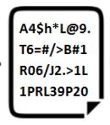
Code-based Encryption
McEliece Public-Key Cryptosystem
Alice
Bob
P, S, G
G’
Key Generator
Module
Encryption Module
e
P⁻¹, S⁻¹, H
Random Error
Decryption Module
Notes:
McEliece public-key cryptosystem has 3 major modules. First is key generator module. It takes care of generating the secret key or private key for Alice and also generates the second public key. Bob uses the generated public key to encode the message and create a codeword and then adds random error to further obfuscate the code word to get the ciphertext. Alice after receiving the ciphertext can decrypt using the secret keys and then performing error-correction to recover the final message.

Slide 12




Code-based Encryption
k
Key Generation (Alice)
Pick two random matrices:
k$×$k non-singular binary matrix S:
n$×$n permutation binary matrix P:
Compute:
k$×$n matrix G’ = S$×$G$×$P
s
k
P
n
n
s
G
P
G’
$$×$$
$$×$$
$$=$$
Notes:
Let’s start with Key-generation. The process involves

Slide 13

Code-based Encryption
Key Generation
Public key (t, G’):
t,
Private key (S, G, P):
Remember G’ = S$×$G$×$P
G’
s
G
P
Notes:
G’ will be the public key generated by the key generation module, t i.e. the number of bits that can be error corrected will also be publicly known. While S, G, and P will remain with Alice as her secret keys. Let’s see how to generate each of these matrix.

Slide 14
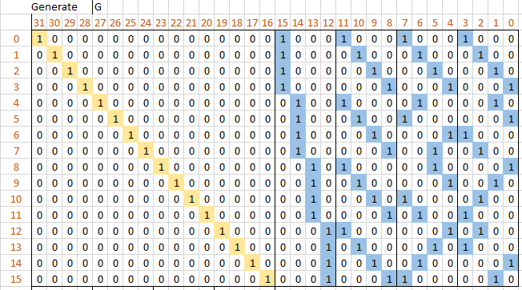
Code-based Encryption
G (the private key)
From a t= 2 double error-correcting OLSC code
Identity Matrix
M1
M2
L1
L2
Notes:
A typical generator matrix will look like this. It comprises of few other matrices.

Slide 15
Generator Matrix: G
Steps to generate Generator Matrix:
Choose a prime, q and t will identify the number of error correction bits
Compute n and k
n = 2 * q * t
k = q² + n
Generate the parity check matrix, H of order n x k
Transpose the parity check matrix (without the identity matrix) and generate G of order n x k
Example:
q = 4
t = 2
n = 2 * 4 * 2 = 16
k = q² + n = 4*4 + 16 = 32

Slide 16
Generator Matrix: G
M1
Submatrix of order q x q²
0 | 0 | 0 | 0
0 | 0 | 0 | 0
0 | 0 | 0 | 0
0 | 0 | 0 | 0
1st Matrix of order q x q

Slide 17
Generator Matrix: G
M1
Submatrix of order q x q²
0 | 0 | 0 | 0 | 0 | 0 | 0 | 0
0 | 0 | 0 | 0 | 0 | 0 | 0 | 0
0 | 0 | 0 | 0 | 0 | 0 | 0 | 0
0 | 0 | 0 | 0 | 0 | 0 | 0 | 0
2nd Matrix of order q x q

Slide 18
Generator Matrix: G
M1
Submatrix of order q x q²
0 | 0 | 0 | 0 | 0 | 0 | 0 | 0 | 0 | 0 | 0 | 0
0 | 0 | 0 | 0 | 0 | 0 | 0 | 0 | 0 | 0 | 0 | 0
0 | 0 | 0 | 0 | 0 | 0 | 0 | 0 | 0 | 0 | 0 | 0
0 | 0 | 0 | 0 | 0 | 0 | 0 | 0 | 0 | 0 | 0 | 0
3rd Matrix of order q x q

Slide 19
Generator Matrix: G
M1
Submatrix of order q x q²
0 | 0 | 0 | 0 | 0 | 0 | 0 | 0 | 0 | 0 | 0 | 0 | 0 | 0 | 0 | 0
0 | 0 | 0 | 0 | 0 | 0 | 0 | 0 | 0 | 0 | 0 | 0 | 0 | 0 | 0 | 0
0 | 0 | 0 | 0 | 0 | 0 | 0 | 0 | 0 | 0 | 0 | 0 | 0 | 0 | 0 | 0
0 | 0 | 0 | 0 | 0 | 0 | 0 | 0 | 0 | 0 | 0 | 0 | 0 | 0 | 0 | 0
4th Matrix of order q x q

Slide 20
Generator Matrix: G
M1
Submatrix of order q x q²
1 | 1 | 1 | 1 | 0 | 0 | 0 | 0 | 0 | 0 | 0 | 0 | 0 | 0 | 0 | 0
0 | 0 | 0 | 0 | 0 | 0 | 0 | 0 | 0 | 0 | 0 | 0 | 0 | 0 | 0 | 0
0 | 0 | 0 | 0 | 0 | 0 | 0 | 0 | 0 | 0 | 0 | 0 | 0 | 0 | 0 | 0
0 | 0 | 0 | 0 | 0 | 0 | 0 | 0 | 0 | 0 | 0 | 0 | 0 | 0 | 0 | 0
1st Matrix will have 1s in the 1st row

Slide 21
Generator Matrix: G
M1
Submatrix of order q x q²
1 | 1 | 1 | 1 | 0 | 0 | 0 | 0 | 0 | 0 | 0 | 0 | 0 | 0 | 0 | 0
0 | 0 | 0 | 0 | 1 | 1 | 1 | 1 | 0 | 0 | 0 | 0 | 0 | 0 | 0 | 0
0 | 0 | 0 | 0 | 0 | 0 | 0 | 0 | 0 | 0 | 0 | 0 | 0 | 0 | 0 | 0
0 | 0 | 0 | 0 | 0 | 0 | 0 | 0 | 0 | 0 | 0 | 0 | 0 | 0 | 0 | 0
2nd Matrix will have 1s in the 2nd row

Slide 22
Generator Matrix: G
M1
Submatrix of order q x q²
1 | 1 | 1 | 1 | 0 | 0 | 0 | 0 | 0 | 0 | 0 | 0 | 0 | 0 | 0 | 0
0 | 0 | 0 | 0 | 1 | 1 | 1 | 1 | 0 | 0 | 0 | 0 | 0 | 0 | 0 | 0
0 | 0 | 0 | 0 | 0 | 0 | 0 | 0 | 1 | 1 | 1 | 1 | 0 | 0 | 0 | 0
0 | 0 | 0 | 0 | 0 | 0 | 0 | 0 | 0 | 0 | 0 | 0 | 0 | 0 | 0 | 0
3rd Matrix will have 1s in the 3rd row

Slide 23
Generator Matrix: G
M1
Submatrix of order q x q²
1 | 1 | 1 | 1 | 0 | 0 | 0 | 0 | 0 | 0 | 0 | 0 | 0 | 0 | 0 | 0
0 | 0 | 0 | 0 | 1 | 1 | 1 | 1 | 0 | 0 | 0 | 0 | 0 | 0 | 0 | 0
0 | 0 | 0 | 0 | 0 | 0 | 0 | 0 | 1 | 1 | 1 | 1 | 0 | 0 | 0 | 0
0 | 0 | 0 | 0 | 0 | 0 | 0 | 0 | 0 | 0 | 0 | 0 | 1 | 1 | 1 | 1
4th Matrix will have 1s in the 4th row

Slide 24
Generator Matrix: G
M1
Submatrix of order q x q²
1 | 1 | 1 | 1 | 0 | 0 | 0 | 0 | 0 | 0 | 0 | 0 | 0 | 0 | 0 | 0
0 | 0 | 0 | 0 | 1 | 1 | 1 | 1 | 0 | 0 | 0 | 0 | 0 | 0 | 0 | 0
0 | 0 | 0 | 0 | 0 | 0 | 0 | 0 | 1 | 1 | 1 | 1 | 0 | 0 | 0 | 0
0 | 0 | 0 | 0 | 0 | 0 | 0 | 0 | 0 | 0 | 0 | 0 | 1 | 1 | 1 | 1

Slide 25
Generator Matrix: G
M2
Submatrix of order q x q²
1 | 0 | 0 | 0 | 1 | 0 | 0 | 0 | 1 | 0 | 0 | 0 | 1 | 0 | 0 | 0
0 | 1 | 0 | 0 | 0 | 1 | 0 | 0 | 0 | 1 | 0 | 0 | 0 | 1 | 0 | 0
0 | 0 | 1 | 0 | 0 | 0 | 1 | 0 | 0 | 0 | 1 | 0 | 0 | 0 | 1 | 0
0 | 0 | 0 | 1 | 0 | 0 | 0 | 1 | 0 | 0 | 0 | 1 | 0 | 0 | 0 | 1
Identity Matrix of order q x q

Slide 26
Generator Matrix: G
Latin Square
A Latin square is an n × n matrix filled with n different symbols, each occurring exactly once in each row and exactly once in each column.
An example of a 4x4 Latin square is:
4 | 1 | 2 | 3
1 | 4 | 3 | 2
2 | 3 | 4 | 1
3 | 2 | 1 | 4

Slide 27
Generator Matrix: G
Orthogonal Latin Squares
A pair of Latin squares A=(a_{ij}), B=(b_{ij}) of order n are orthogonal iff the ordered pairs (a_{ij}, b_{ij}) are distinct for all i and j
An example of 4x4 orthogonal Latin square pairs is:
A
4 | 1 | 2 | 3
1 | 4 | 3 | 2
2 | 3 | 4 | 1
3 | 2 | 1 | 4
B
4 | 1 | 2 | 3
2 | 3 | 4 | 1
3 | 2 | 1 | 4
1 | 4 | 3 | 2
4,4 | 1,1 | 2,2 | 3,3
1,2 | 4,3 | 3,4 | 2,1
2,3 | 3,2 | 4,1 | 1,4
3,1 | 2,4 | 1,3 | 4,2
Euler Square

Slide 28
Generator Matrix: G
Orthogonal Latin Square: Binary Representation
0 | 0 | 0 | 1 | 1 | 0 | 0 | 0 | 0 | 1 | 0 | 0 | 0 | 0 | 1 | 0
1 | 0 | 0 | 0 | 0 | 0 | 0 | 1 | 0 | 0 | 1 | 0 | 0 | 1 | 0 | 0
0 | 1 | 0 | 0 | 0 | 0 | 1 | 0 | 0 | 0 | 0 | 1 | 1 | 0 | 0 | 0
0 | 0 | 1 | 0 | 0 | 1 | 0 | 0 | 1 | 0 | 0 | 0 | 0 | 0 | 0 | 1
4 | 1 | 2 | 3
1 | 4 | 3 | 2
2 | 3 | 4 | 1
3 | 2 | 1 | 4
Incidence Matrix
1
1 | 0 | 0 | 0
2
0 | 1 | 0 | 0
3
0 | 0 | 1 | 0
4
0 | 0 | 0 | 1

Slide 29
Generator Matrix: G
1 | 1 | 1 | 1 | 0 | 0 | 0 | 0 | 0 | 0 | 0 | 0 | 0 | 0 | 0 | 0
0 | 0 | 0 | 0 | 1 | 1 | 1 | 1 | 0 | 0 | 0 | 0 | 0 | 0 | 0 | 0
0 | 0 | 0 | 0 | 0 | 0 | 0 | 0 | 1 | 1 | 1 | 1 | 0 | 0 | 0 | 0
0 | 0 | 0 | 0 | 0 | 0 | 0 | 0 | 0 | 0 | 0 | 0 | 1 | 1 | 1 | 1
0 | 0 | 0 | 1 | 1 | 0 | 0 | 0 | 0 | 1 | 0 | 0 | 0 | 0 | 1 | 0
1 | 0 | 0 | 0 | 0 | 0 | 0 | 1 | 0 | 0 | 1 | 0 | 0 | 1 | 0 | 0
0 | 1 | 0 | 0 | 0 | 0 | 1 | 0 | 0 | 0 | 0 | 1 | 1 | 0 | 0 | 0
0 | 0 | 1 | 0 | 0 | 1 | 0 | 0 | 1 | 0 | 0 | 0 | 0 | 0 | 0 | 1
M1 L1
M2 L2
1 | 0 | 0 | 0 | 1 | 0 | 0 | 0 | 1 | 0 | 0 | 0 | 1 | 0 | 0 | 0
0 | 1 | 0 | 0 | 0 | 1 | 0 | 0 | 0 | 1 | 0 | 0 | 0 | 1 | 0 | 0
0 | 0 | 1 | 0 | 0 | 0 | 1 | 0 | 0 | 0 | 1 | 0 | 0 | 0 | 1 | 0
0 | 0 | 0 | 1 | 0 | 0 | 0 | 1 | 0 | 0 | 0 | 1 | 0 | 0 | 0 | 1
0 | 0 | 0 | 1 | 1 | 0 | 0 | 0 | 0 | 1 | 0 | 0 | 0 | 0 | 1 | 0
0 | 1 | 0 | 0 | 0 | 0 | 1 | 0 | 0 | 0 | 0 | 1 | 1 | 0 | 0 | 0
0 | 0 | 1 | 0 | 0 | 1 | 0 | 0 | 1 | 0 | 0 | 0 | 0 | 0 | 0 | 1
1 | 0 | 0 | 0 | 0 | 0 | 0 | 1 | 0 | 0 | 1 | 0 | 0 | 1 | 0 | 0

Slide 30
Generator Matrix: G
Parity Check Matrix, H
1 | 1 | 1 | 1 | 0 | 0 | 0 | 0 | 0 | 0 | 0 | 0 | 0 | 0 | 0 | 0
0 | 0 | 0 | 0 | 1 | 1 | 1 | 1 | 0 | 0 | 0 | 0 | 0 | 0 | 0 | 0
0 | 0 | 0 | 0 | 0 | 0 | 0 | 0 | 1 | 1 | 1 | 1 | 0 | 0 | 0 | 0
0 | 0 | 0 | 0 | 0 | 0 | 0 | 0 | 0 | 0 | 0 | 0 | 1 | 1 | 1 | 1
1 | 0 | 0 | 0 | 0 | 0 | 0 | 0 | 0 | 0 | 0 | 0 | 0 | 0 | 0 | 0
0 | 1 | 0 | 0 | 0 | 0 | 0 | 0 | 0 | 0 | 0 | 0 | 0 | 0 | 0 | 0
0 | 0 | 1 | 0 | 0 | 0 | 0 | 0 | 0 | 0 | 0 | 0 | 0 | 0 | 0 | 0
0 | 0 | 0 | 1 | 0 | 0 | 0 | 0 | 0 | 0 | 0 | 0 | 0 | 0 | 0 | 0
0 | 0 | 0 | 0 | 1 | 0 | 0 | 0 | 0 | 0 | 0 | 0 | 0 | 0 | 0 | 0
0 | 0 | 0 | 0 | 0 | 1 | 0 | 0 | 0 | 0 | 0 | 0 | 0 | 0 | 0 | 0
0 | 0 | 0 | 0 | 0 | 0 | 1 | 0 | 0 | 0 | 0 | 0 | 0 | 0 | 0 | 0
0 | 0 | 0 | 0 | 0 | 0 | 0 | 1 | 0 | 0 | 0 | 0 | 0 | 0 | 0 | 0
0 | 0 | 0 | 0 | 0 | 0 | 0 | 0 | 1 | 0 | 0 | 0 | 0 | 0 | 0 | 0
0 | 0 | 0 | 0 | 0 | 0 | 0 | 0 | 0 | 1 | 0 | 0 | 0 | 0 | 0 | 0
0 | 0 | 0 | 0 | 0 | 0 | 0 | 0 | 0 | 0 | 1 | 0 | 0 | 0 | 0 | 0
0 | 0 | 0 | 0 | 0 | 0 | 0 | 0 | 0 | 0 | 0 | 1 | 0 | 0 | 0 | 0
0 | 0 | 0 | 0 | 0 | 0 | 0 | 0 | 0 | 0 | 0 | 0 | 1 | 0 | 0 | 0
0 | 0 | 0 | 0 | 0 | 0 | 0 | 0 | 0 | 0 | 0 | 0 | 0 | 1 | 0 | 0
0 | 0 | 0 | 0 | 0 | 0 | 0 | 0 | 0 | 0 | 0 | 0 | 0 | 0 | 1 | 0
0 | 0 | 0 | 0 | 0 | 0 | 0 | 0 | 0 | 0 | 0 | 0 | 0 | 0 | 0 | 1
M1
1 | 0 | 0 | 0 | 1 | 0 | 0 | 0 | 1 | 0 | 0 | 0 | 1 | 0 | 0 | 0
0 | 1 | 0 | 0 | 0 | 1 | 0 | 0 | 0 | 1 | 0 | 0 | 0 | 1 | 0 | 0
0 | 0 | 1 | 0 | 0 | 0 | 1 | 0 | 0 | 0 | 1 | 0 | 0 | 0 | 1 | 0
0 | 0 | 0 | 1 | 0 | 0 | 0 | 1 | 0 | 0 | 0 | 1 | 0 | 0 | 0 | 1
M2
Identity Matrix
0 | 0 | 0 | 1 | 1 | 0 | 0 | 0 | 0 | 1 | 0 | 0 | 0 | 0 | 1 | 0
1 | 0 | 0 | 0 | 0 | 0 | 0 | 1 | 0 | 0 | 1 | 0 | 0 | 1 | 0 | 0
0 | 1 | 0 | 0 | 0 | 0 | 1 | 0 | 0 | 0 | 0 | 1 | 1 | 0 | 0 | 0
0 | 0 | 1 | 0 | 0 | 1 | 0 | 0 | 1 | 0 | 0 | 0 | 0 | 0 | 0 | 1
L1
0 | 0 | 0 | 1 | 1 | 0 | 0 | 0 | 0 | 1 | 0 | 0 | 0 | 0 | 1 | 0
0 | 1 | 0 | 0 | 0 | 0 | 1 | 0 | 0 | 0 | 0 | 1 | 1 | 0 | 0 | 0
0 | 0 | 1 | 0 | 0 | 1 | 0 | 0 | 1 | 0 | 0 | 0 | 0 | 0 | 0 | 1
1 | 0 | 0 | 0 | 0 | 0 | 0 | 1 | 0 | 0 | 1 | 0 | 0 | 1 | 0 | 0
L2
Notes:
Parity check matrix forms the basis of error correction or we can even call it as the decoding matrix.

Slide 31
Generator Matrix: G
Generator Matrix, G
1 | 0 | 0 | 0 | 0 | 0 | 0 | 0 | 0 | 0 | 0 | 0 | 0 | 0 | 0 | 0
0 | 1 | 0 | 0 | 0 | 0 | 0 | 0 | 0 | 0 | 0 | 0 | 0 | 0 | 0 | 0
0 | 0 | 1 | 0 | 0 | 0 | 0 | 0 | 0 | 0 | 0 | 0 | 0 | 0 | 0 | 0
0 | 0 | 0 | 1 | 0 | 0 | 0 | 0 | 0 | 0 | 0 | 0 | 0 | 0 | 0 | 0
0 | 0 | 0 | 0 | 1 | 0 | 0 | 0 | 0 | 0 | 0 | 0 | 0 | 0 | 0 | 0
0 | 0 | 0 | 0 | 0 | 1 | 0 | 0 | 0 | 0 | 0 | 0 | 0 | 0 | 0 | 0
0 | 0 | 0 | 0 | 0 | 0 | 1 | 0 | 0 | 0 | 0 | 0 | 0 | 0 | 0 | 0
0 | 0 | 0 | 0 | 0 | 0 | 0 | 1 | 0 | 0 | 0 | 0 | 0 | 0 | 0 | 0
0 | 0 | 0 | 0 | 0 | 0 | 0 | 0 | 1 | 0 | 0 | 0 | 0 | 0 | 0 | 0
0 | 0 | 0 | 0 | 0 | 0 | 0 | 0 | 0 | 1 | 0 | 0 | 0 | 0 | 0 | 0
0 | 0 | 0 | 0 | 0 | 0 | 0 | 0 | 0 | 0 | 1 | 0 | 0 | 0 | 0 | 0
0 | 0 | 0 | 0 | 0 | 0 | 0 | 0 | 0 | 0 | 0 | 1 | 0 | 0 | 0 | 0
0 | 0 | 0 | 0 | 0 | 0 | 0 | 0 | 0 | 0 | 0 | 0 | 1 | 0 | 0 | 0
0 | 0 | 0 | 0 | 0 | 0 | 0 | 0 | 0 | 0 | 0 | 0 | 0 | 1 | 0 | 0
0 | 0 | 0 | 0 | 0 | 0 | 0 | 0 | 0 | 0 | 0 | 0 | 0 | 0 | 1 | 0
0 | 0 | 0 | 0 | 0 | 0 | 0 | 0 | 0 | 0 | 0 | 0 | 0 | 0 | 0 | 1
1 | 0 | 0 | 0
1 | 0 | 0 | 0
1 | 0 | 0 | 0
1 | 0 | 0 | 0
0 | 1 | 0 | 0
0 | 1 | 0 | 0
0 | 1 | 0 | 0
0 | 1 | 0 | 0
0 | 0 | 1 | 0
0 | 0 | 1 | 0
0 | 0 | 1 | 0
0 | 0 | 1 | 0
0 | 0 | 0 | 1
0 | 0 | 0 | 1
0 | 0 | 0 | 1
0 | 0 | 0 | 1
1 | 0 | 0 | 0
0 | 1 | 0 | 0
0 | 0 | 1 | 0
0 | 0 | 0 | 1
1 | 0 | 0 | 0
0 | 1 | 0 | 0
0 | 0 | 1 | 0
0 | 0 | 0 | 1
1 | 0 | 0 | 0
0 | 1 | 0 | 0
0 | 0 | 1 | 0
0 | 0 | 0 | 1
1 | 0 | 0 | 0
0 | 1 | 0 | 0
0 | 0 | 1 | 0
0 | 0 | 0 | 1
0 | 1 | 0 | 0
0 | 0 | 1 | 0
0 | 0 | 0 | 1
1 | 0 | 0 | 0
1 | 0 | 0 | 0
0 | 0 | 0 | 1
0 | 0 | 1 | 0
0 | 1 | 0 | 0
0 | 0 | 0 | 1
1 | 0 | 0 | 0
0 | 1 | 0 | 0
0 | 0 | 1 | 0
0 | 0 | 1 | 0
0 | 1 | 0 | 0
1 | 0 | 0 | 0
0 | 0 | 0 | 1
0 | 0 | 0 | 1
0 | 1 | 0 | 0
0 | 0 | 1 | 0
1 | 0 | 0 | 0
1 | 0 | 0 | 0
0 | 0 | 1 | 0
0 | 1 | 0 | 0
0 | 0 | 0 | 1
0 | 0 | 1 | 0
1 | 0 | 0 | 0
0 | 0 | 0 | 1
0 | 1 | 0 | 0
0 | 1 | 0 | 0
0 | 0 | 0 | 1
1 | 0 | 0 | 0
0 | 0 | 1 | 0
Identity Matrix
M1^{T}
M2^{T}
L1^{T}
L2^{T}
Here, T stands for Transpose of a matrix

Slide 32
Non-singular Matrix: S
Properties of Non-singular Matrix:
Must be a square matrix
In our case, order is q² x q²
Determinant should not be zero
There exists an inverse of the matrix
Generate a random binary square matrix of order n x n
Compute its determinant to check if it is non-zero
Compute the inverse of the matrix using
S * S⁻¹ = I, where I is the identity matrix

Slide 33
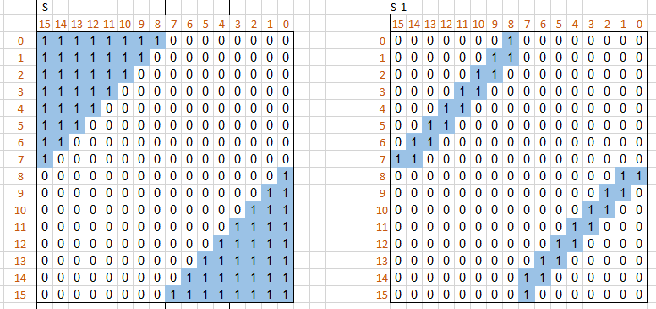
Non-singular Matrix: S
S and its inverse (the private key)

Slide 34
Permutation Matrix: P
Obtained by permuting the rows of an identity matrix
Properties of Permutation Matrix:
Must be a square matrix
Order of k x k
Every row and column contains precisely a single 1 with 0s elsewhere
Non-singular matrix
Satisfies P * P^{T} = I
Compute the inverse of the matrix using
P * P⁻¹ = I where P⁻¹ = P^{T}

Slide 35
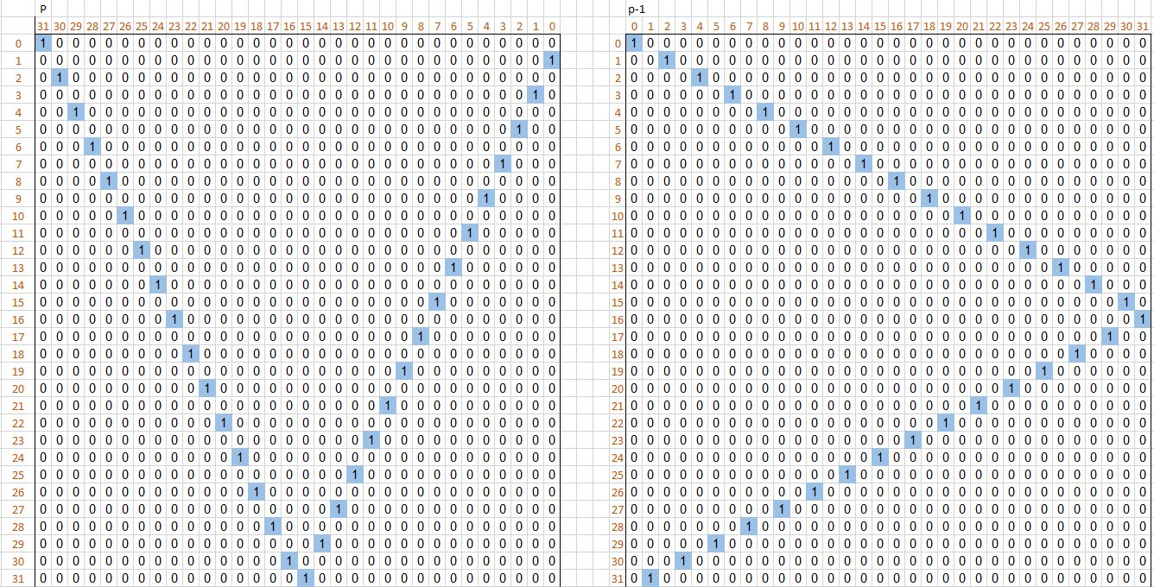
Permutation Matrix: P
P and its inverse (the private key)

Slide 36
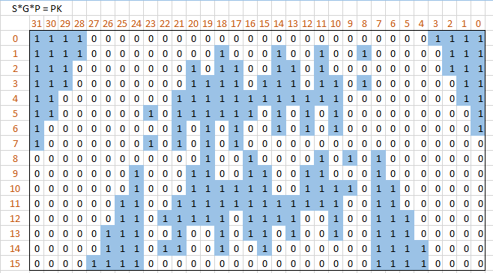

Code-based Encryption
G’ = S$×$G$×$P the public key
Notes:
Once we have all the three matrices, S, G and P we can multiply all the three matrices and generate the public key G’

Slide 37
Code-based Encryption
Key Generation
Public key (t, G’):
t,
Private key (S, G, P):
Remember G’ = S$×$G$×$P
G’
s
G
P
Notes:
So at the end of key generation we will have Public Key G’ and three Private or secret keys S, G and P

Slide 38





Code-based Encryption
Encryption (Bob to Alice)
Message (plaintext) encrypted to codeword
C
G’
$$×$$
m
$$=$$
$$×$$
$$=$$
Notes:
Next module is the Encryption module, Bob has a plaintext message m as k-bit vector. He will multiply his message vector with the public key G’ and thus compute the codeword, C.

Slide 39




Code-based Encryption
Encryption (Bob to Alice)
Message (plaintext) encrypted to codeword
Codeword obfuscated by error to cipher
C
e (t of 1’s)
Cipher
$$+$$
$$=$$
$$+$$
$$=$$
Notes:
Codeword is further obfuscated by adding the random error e. This gives Bob the final ciphertext.

Slide 40


Code-based Encryption
Decryption (Alice)
(Remember G’ = S$×$G$×$P)
Cipher$×$P⁻¹ = (m$×$G’$+$ e) $×$P⁻¹ = (m$×$S$×\text{G}\text{)}+$ (e$×$P⁻¹)
$$×$$
=
Notes:
In decryption, first step is to remove the Permutation matrix by multiplying by P inverse.

Slide 41

Code-based Encryption
Decryption (Alice)
(Remember G’ = S$×$G$×$P)
Cipher$×$P⁻¹ = (m$×$G’$+$ e) $×$P⁻¹ = (m$×$S$×\text{G}\text{)}+$ (e$×$P⁻¹)
Err-correct (m $×\text{S}×\text{G}+$ (e$×$P⁻¹)) = m $×\text{S}$
Err-correct ( )
?
Notes:
Second step is to perform error correction. Error Correction is performed using the parity check matrix. To cancel out G we will use the parity check matrix H.

Slide 42


Code-based Encryption
Attacker does not know: S, G, P
Thus he/she cannot compute:
S⁻¹, Err-correct( ), P⁻¹
Therefore, he/she does not know m
Decryption (Alice)
(Remember G’ = S$×$G$×$P)
Cipher$×$P⁻¹ = (m$×$G’$+$ e) $×$P⁻¹ = (m$×$S$×\text{G}\text{)}+$ (e$×$P⁻¹)
Err-correct (m $×\text{S}×\text{G}+$ (e$×$P⁻¹)) = m $×\text{S}$
m $×\text{S}×\text{S}\text{−1}$ = m
m
$$×$$
=
Notes:
Last step will be to multiply by S inverse to cancel out S and recover the original message m. Remember attacker doesnot know S, G, and P.

Slide 43
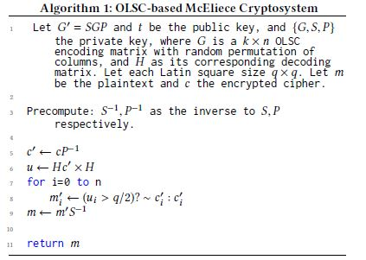
Decryption Algorithm
Error-Correction via Fast Decoding through Majority Voting
Decryption Step-1
Decryption Step-2
Error-correction
Decryption Step-3
Notes:
Hc’ cancels out G from the codeword. But second multiplication, is an actual multiplication when I say actual multiplication I mean that we don’t perform modulo 2 operations on the multiplication result to convert the result to binary matrix. So we will have integer values in the matrix. And then we will check if each value is greater than q/2. If ui is greater than q/2 than we can say that majority voted for that bit to be in error and that the corresponding bit in the ciphertext needs to be flipped, viceversa otherwise.

Slide 44
Security: Key Space Exploration
For a prime number, q
q-1 orthogonal Latin squares
Number of Orthogonal Latin squares that will be used in the generator matrix is given by:
L = 2 * t – 2, where t is the number of random errors that can be corrected
Notes:
There are very few attacks known against the McEliece cryptosystem that can recover the secret key from the public key. But we replaced the goppa codes with OLSC in our scheme. An attacker can try to recover the secret key G from the public key G’ and then decrypt the message. So we need to explore the key space as if for the chosen parameters there exists just one key i.e. one Generator matrix which maps to G’, an attacker might have an advantage here.

Slide 45
Security: Key Space Exploration
Example:
q = 11, L = 11 - 1 = 10
10 = 2 * t – 2, t = 6
No. of bits to be error-corrected, t | No. of orthogonal Latin Squares(2t - 2) | No. of ways to pick Latin squares
1 | 0 | 0
2 | 2 | 10 * 9 = 90
3 | 4 | 10 * 9 * 8 * 7 = 5040
4 | 6 | 10 * 9 * 8 * 7 * 6 * 5 = 151,200
5 | 8 | 10 * 9 * 8 * 7 * 6 * 5 * 4 * 3 = 1,814,400
6 | 10 | 10 * 9 * 8 * 7 * 6 * 5 * 4 * 3 * 2 * 1 = 3,628,800

Slide 46
Security: Key Space Exploration
To correct up to 100 bits of errors
q can be 199
2 * 100 – 2 = 198 and 199 is the next prime
Number of Orthogonal Latin Squares we can get for q = 199 is 198
If we use all 198 orthogonal Latin squares to correct 100 bits in errors, key space will be
198! = 1.98155243 E+370
Notes:
So as the key space is large, it will be hard for an attacker to have a direct correlation between the public key and the secret key.

Slide 47
Implementation
Generate G, S, and P in software
Computations in Hardware
Key generation
Matrix multiplication
Encryption
Matrix-vector multiplication
Vector addition
Decryption
Matrix-vector multiplication
???
Notes:
Can we do matrix-multiplication in software? When the public key will be known anyways publicly, do we need to do it hardware?

Slide 48

Code-based Encryption
McEliece cryptosystem
Post-quantum secure key size:
k$×$n matrix G’: k = 5413, n = 6960, t = 119
Key size: 1mb for 128-bit security (RSA usually 2048 bits)
G’
Notes:
To summarize,

Slide 49

Any Questions?

